Slide 1


New presentation
Use these slides as a starting point for customizing your presentation.
Open the Plus add-on for more options. Learn more about Plus.
Plus tip:
December 7, 2023

Slide 2
Agenda
Introduction to Student Attendance Management System
Core Functionalities
Web-Based Interface and Firebase Integration
User Interaction and Editing Capability
Security Measures: Session-Based Authentication and OTP Verification
Technology Stack
Potential Use Cases
Future Development Scope
Summary
Question & Answer

Slide 3
Introduction to Student Attendance Management System
1
2
3
Comprehensive web application for managing student attendance
Includes user-friendly interface and robust backend technology
Aims to simplify and streamline the process of managing and analyzing student attendance data
You can customize this slide by adding specific details about the target users and the unique value proposition of the system.
Plus tip:

Slide 4
Core Functionalities
The system tracks and manages student attendance, with the ability to record and analyze attendance trends over time.
It utilizes Firebase Realtime Database for real-time data processing and scalability.
1
4
It maintains a database of student information, including names, majors, academic standing, and other details.
The system allows user interaction and has editing capabilities for managing student records.
2
5
The application uses a web interface, ensuring accessibility for administrators, teachers, and students.
It implements session-based authentication and email-based OTP verification for security.
Customize the bullet points to highlight the key core functionalities of the Student Attendance Management System. You can also provide specific examples of how each functionality benefits users.
3
6
Plus tip:

Slide 5
Web-Based Interface and Firebase Integration
Web-Based Interface
Firebase Integration
The system is accessible through a web browser, ensuring convenience and accessibility for users.
Administrators, teachers, and students can interact with the system via the web interface.
The system is accessible through a web browser, ensuring convenience and accessibility for users.
Administrators, teachers, and students can interact with the system via the web interface.
Highlight the user interaction aspects and the real-time data processing capabilities for a more engaging presentation.
Plus tip:

Slide 6
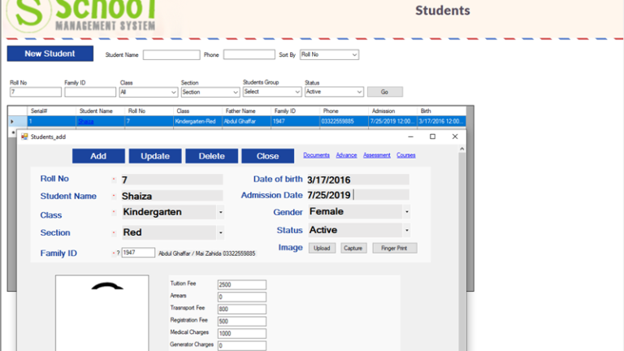
User Interaction and Editing Capability
Key Points
The system allows quick and easy updates to student records without navigating away from the main interface.
Modal forms are used for editing attendance data for each student, enhancing user experience.
The interface is designed to be user-friendly, allowing seamless interaction for teachers, administrators, and students.
The system ensures data accuracy and integrity through robust data validation and error handling.
You can customize the user interaction and editing capabilities based on the specific needs and preferences of the educational institution. Consider incorporating more interactive elements to engage users.
Plus tip:

Slide 7
Security Measures: Session-Based Authentication and OTP Verification
Session-Based Authentication is implemented to emphasize on security and user session management.
The use of Email-Based OTP Verification adds an extra layer of security, crucial for protecting sensitive student data.
Firebase Realtime Database ensures secure real-time data processing with built-in authentication and security rules.
The system prioritizes data security by adopting multiple layers of user verification and authentication.
Emphasize the importance of these security measures in protecting sensitive student data. Consider explaining how these measures align with industry best practices and regulatory requirements.
Plus tip:

Slide 8
Technology Stack
Frontend
Backend
Database
The frontend utilizes HTML, CSS, and JavaScript. Bootstrap is used for modals and styling, and JavaScript handles asynchronous data and dynamic content updates.
The backend is built on Flask, a Python web framework known for its lightweight and flexible architecture, suitable for real-time data handling and cloud-based storage.
The system uses Firebase Realtime Database, offering real-time data processing, scalability for large student records, and additional functionalities like authentication and cloud storage.
You can customize the technology stack to align with your institution's existing infrastructure and development preferences. Consider the scalability and security aspects of the chosen technologies.
Plus tip:

Slide 9
Potential Use Cases
Educational institutions can utilize the system for tracking daily student attendance and managing records.
Teachers and administrative staff have the capability to monitor student engagement and participation.
Students, with the appropriate permissions, can view their attendance records for self-assessment and record-keeping.
Customize the use cases to the specific context of the presentation. Highlight how different user roles can benefit from the system.
Plus tip:

Slide 10
Future Development Scope
Advanced Analytics
Extended Functionality
Incorporating more detailed analytics on student attendance, such as identifying patterns and trends, and providing actionable insights for the institution.
Utilizing data on student absence and attendance to implement automated absence alerts for both students and teachers.
Integrating the system with other educational tools, such as Learning Management Systems or student notification platforms.
Developing a mobile app version for the system, allowing for easier access and on-the-go functionality for both students and teachers.
Tailor the future development to the specific needs and goals of the educational institution or organization using the system.
Plus tip:

Slide 11

Summary
Key Points
The system focuses on attendance tracking and student data management.
It uses a web-based interface and integrates with Firebase for real-time data processing.
The application emphasizes user interaction and editing capability, while prioritizing security with session-based authentication and OTP verification.
Customize the summary to highlight specific aspects of the project that are relevant to the audience.
Plus tip:

Slide 12

Question & Answer
Questions
How does the system handle data security, especially in terms of student privacy?
What are the potential challenges in implementing more detailed analytics on student attendance?
How does the web-based interface impact the accessibility of the system for users, particularly in remote learning scenarios?
Be prepared to answer questions regarding the technical aspects, user impact, and potential expansion of the system.
Plus tip:

Slide 13
Time to put the finishing touches on your Plus AI presentation ✨
Just created your first Plus AI deck? Here’s what to try next:
Insert - Choose a layout and create one slide at a time
Rewrite - Shorten, lengthen, or spice up existing slide content
Remix - Transform your slide into a new layout
Design - Customize your slide colors, fonts, and add a logo
Need help? 👉guide.plusdocs.com

